Slide 1
Convolutional Neural Network (CNN) for Image Classification
Deep Learning model for image understanding
Used in computer vision applications
Presented By: Rudrakshi Jaiswal

Slide 2
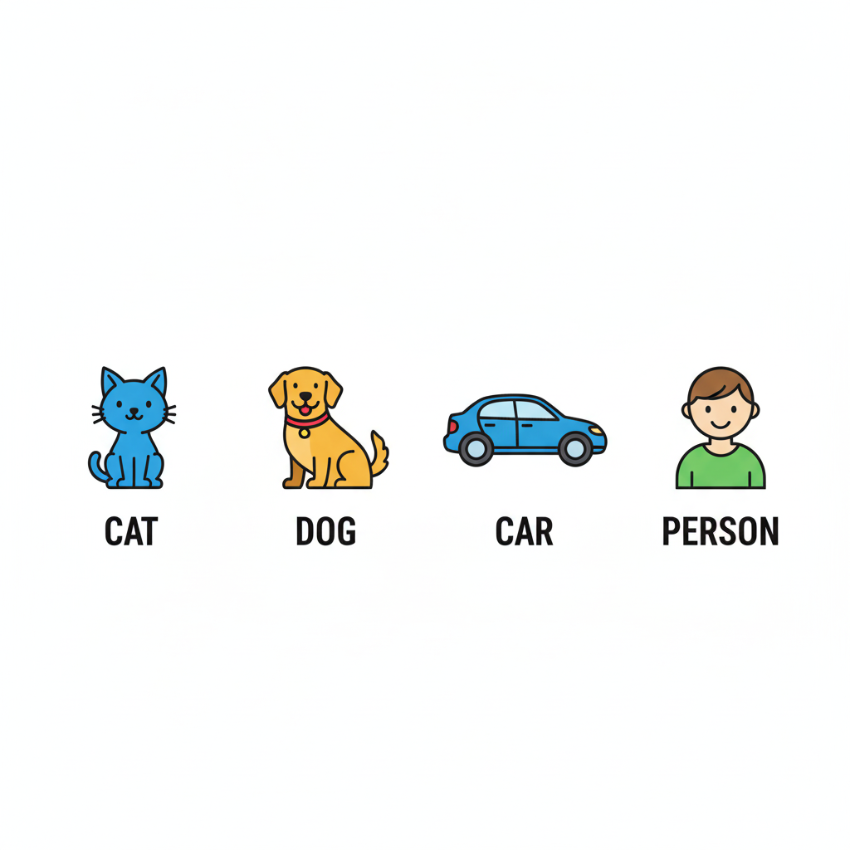
What is Image Classification
Process of identifying objects in an image
Output is a class label

Slide 3
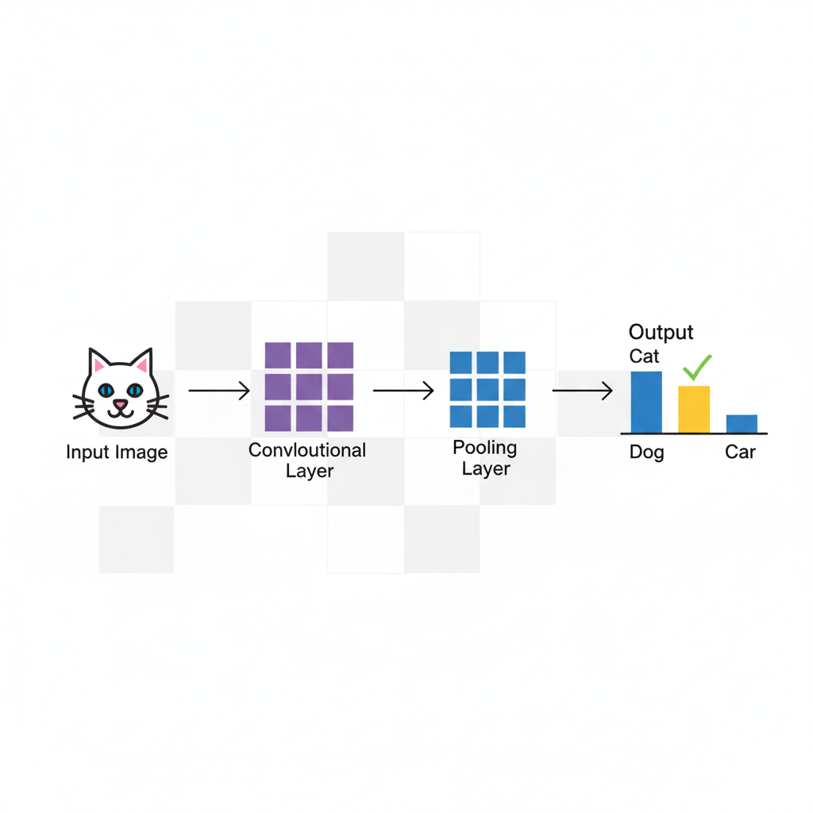
What is CNN
CNN stands for Convolutional Neural Network
Specially designed for image data
Automatically learns important image features
Reduces manual feature extraction

Slide 4
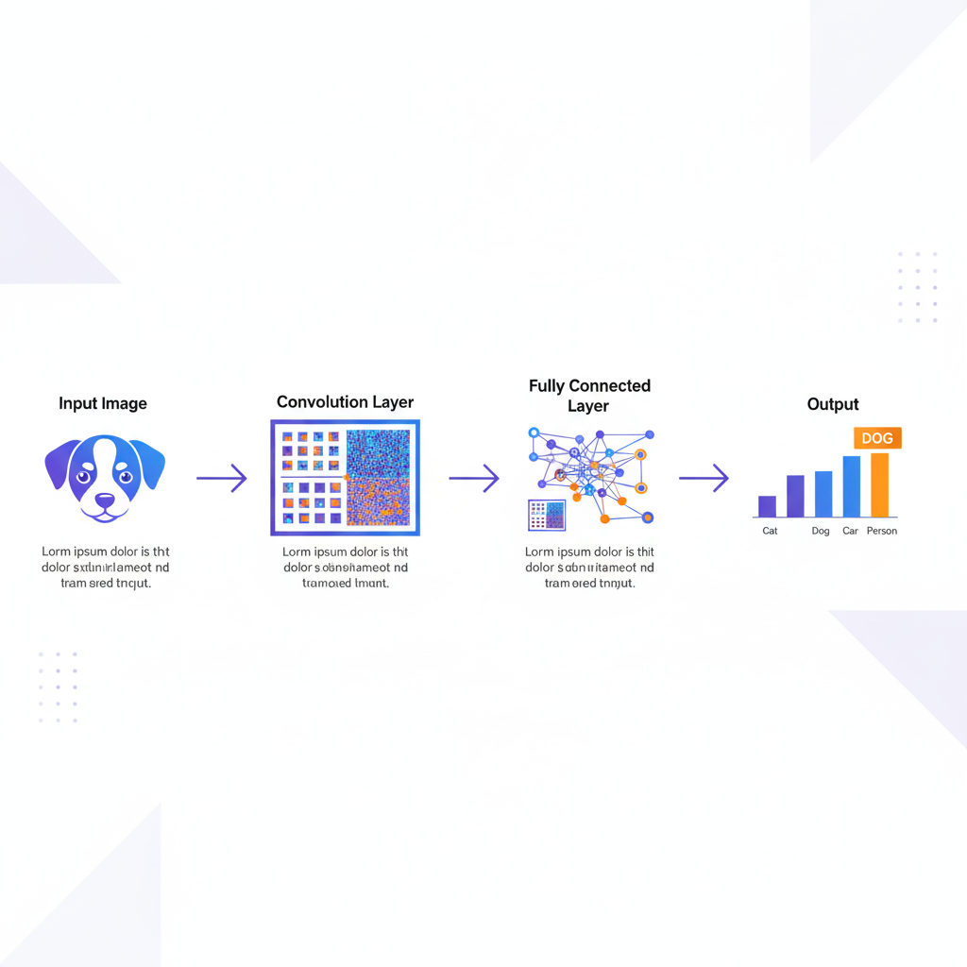
How CNN Works
Input image is given to the network
Features are extracted using convolution layers
Image size is reduced using pooling
Final classification is done using fully connected layers

Slide 5
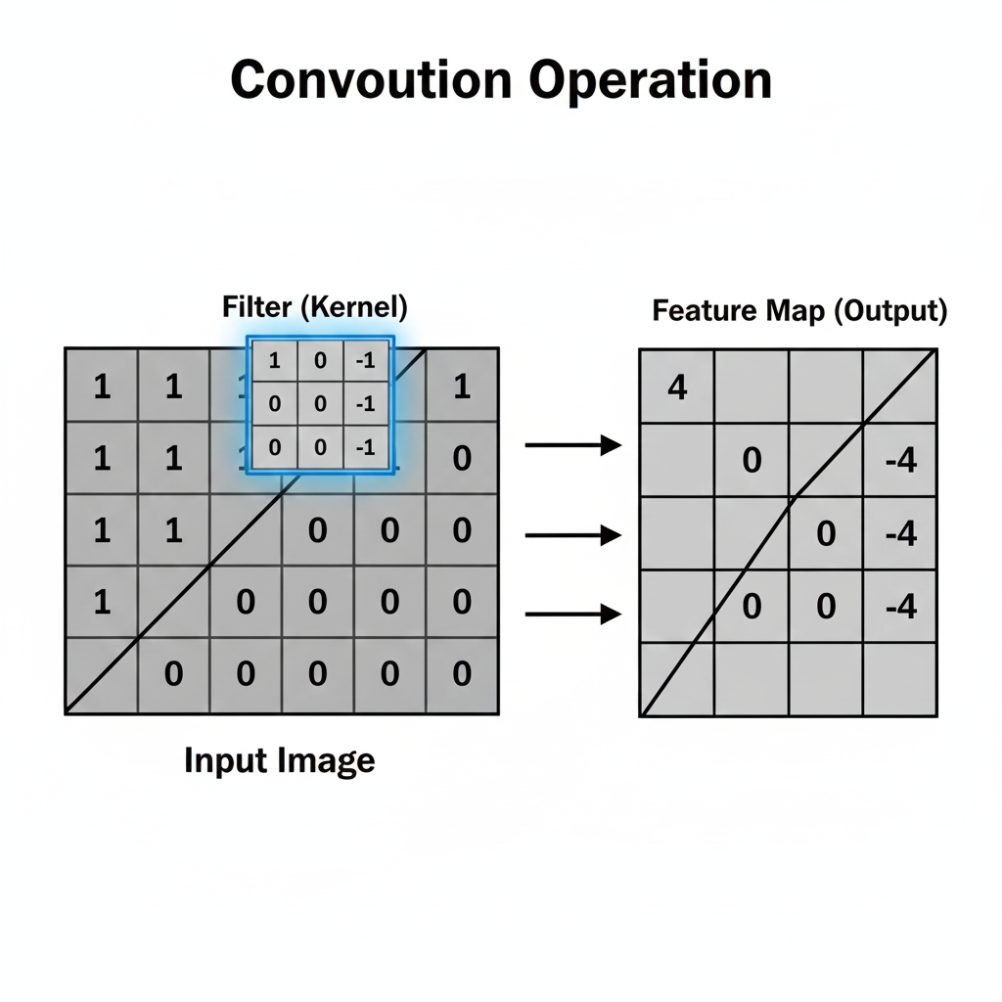
Convolution Layer
Uses small filters called kernels
Detects edges, shapes, and patterns
Helps in feature extraction

Slide 6
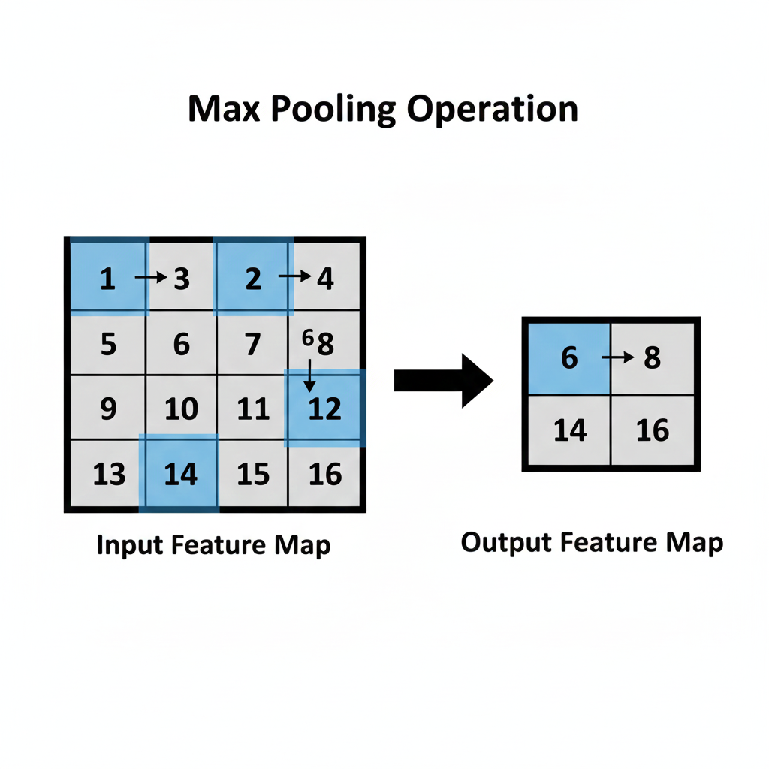
Pooling Layer
Reduces size of feature maps
Keeps important information
Improves speed and performance
Common type: Max Pooling

Slide 7
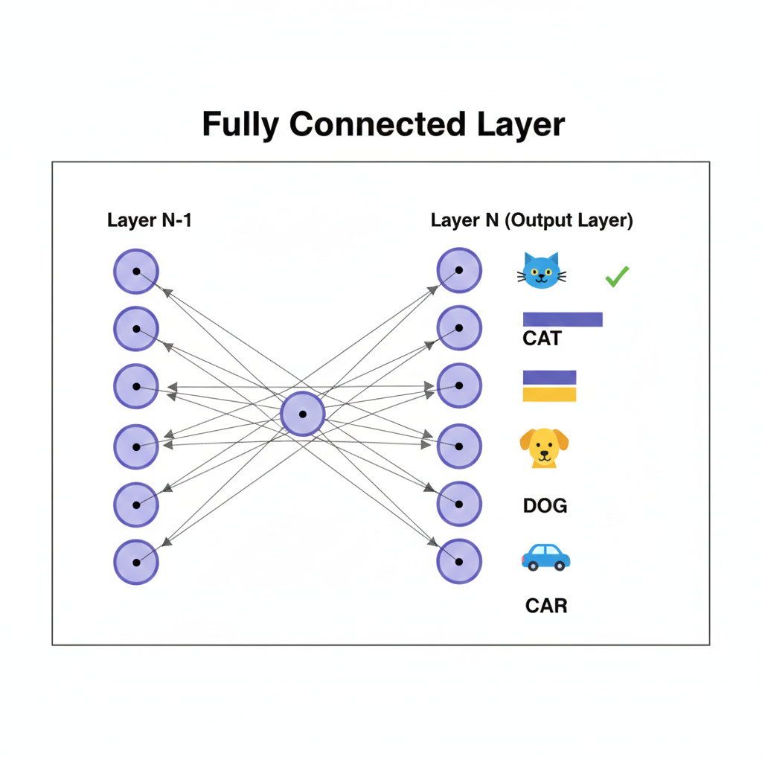
Fully Connected Layer
Combines all extracted features
Makes final prediction
Uses Softmax for classification

Slide 8

Real World Example – Face Recognition
Used in mobile phone unlocking
Security and attendance systems
Identifies facial features like eyes and face shape

Slide 9
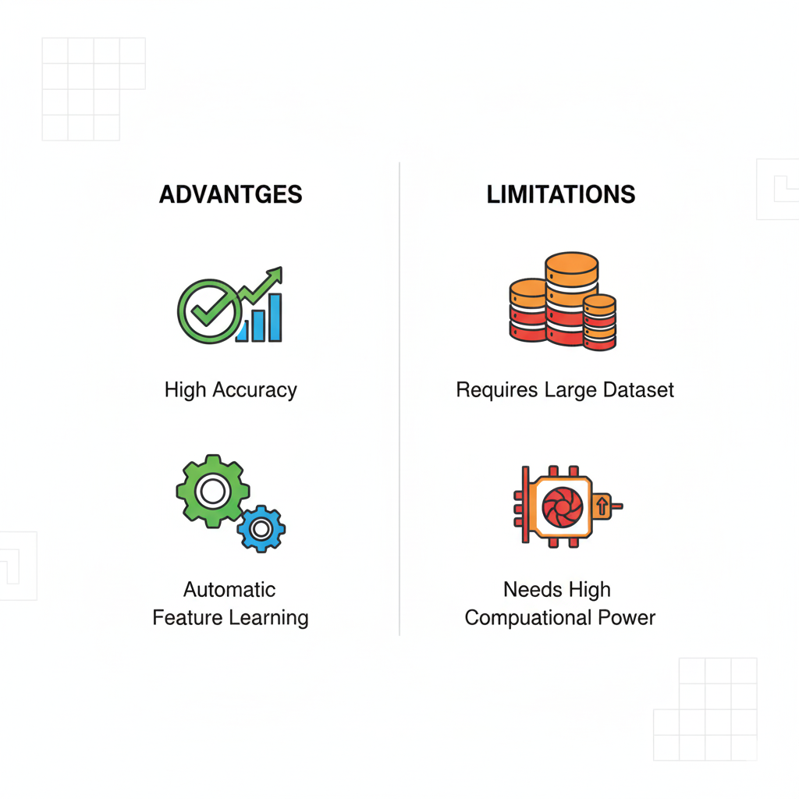
Advantages and Limitations
Advantages
High accuracy
Automatic feature learning
Limitations
Requires large dataset
Needs high computational power

Slide 10

Conclusion
CNN is best suited for image classification
Widely used in real-world applications
Backbone of modern computer vision systems

